Slide 1

Capstone Project MOVIE DATA ANALYSIS
Name: Abhijeet Chandra
Enrolment Number: EN12025086692
Batch Code: DA444S44
Mentor: Sharayoo Dixit

Slide 2
Problem Statement
Movie Data Analysis involves collecting, cleaning, and analyzing movie datasets. Using tools such as Python, MySQL, Excel, and Tableau, the project performs EDA and applies Machine Learning algorithms to predict revenue, profit, and audience ratings. These insights help identify key success factors, guide production and marketing strategies, and enhance decision-making in the film industry.
BUSINESS FOCUS AREAS
Movie Performance Analysis
Cast & Crew Impact
Budget Allocation & Profitability
Runtime & Content Strategy
5. Statistical Analysis
6. RELEASE TRENDS & PROFIT INSIGHTS
7. Profitability and Runtime Analysis in Global Movie Industry
Country, Language, Budget, and Genre Insights in Movie Success
Understanding Movie Success Through Direction, Profitability, Release
10. Profit Prediction & Success Modeling

Slide 3
Data Description
Data Type : Structured Data Total Rows: 4803 Total Columns: 17
DATA DICTIONARY
COLUMN NAME DATATYPE DESCRIPTION
Budget int The total budget allocated for the production of the movie (in $)
Genres string List of genres associated with the movie, separated by commas
Id int Unique identifier for each movie
Original_language string The original language in which the movie was produced
Popularity float A score reflecting how popular the movie is (based on views)
Production_companies string The name(s) of the production company or companies involved
Production_countries string Country or countries where the movie was produced
Release_date string The release date of the movie in YYYY-MM-DD format
Revenue int The total revenue earned by the movie(in $)
Runtime int The duration of the movie in minutes
Status string The release status of the movie
Vote_average float The average rating given by users (on a scale of 0 to 10)
Vote_count int Total number of votes received by the movie
Actors string List of main actors in the movie, separated by commas
Director string Name of the director of the movie
Profit int The net profit (in $)
Title string The name of movie

Slide 4






Tools and Techniques Used
TECHNIQUES USED
TOOLS
1. Python
2. My SQL
3. Excel
4. Tableau
5. Machine Learning
PYTHON- Used for data preprocessing tasks such as data cleaning, transformation, outliers' treatment, Export CSV file.
Executes exploratory data analysis (EDA) to gain insights and understand data patterns and completed five business focus areas and also done Descriptive Analysis.
Provides libraries like Pandas, NumPy, and Scikit-Learn for data manipulation and analysis.
developed four machine learning models with the help of Pandas and Scikit-learn libraries.
2. SQL - Used for EDA (exploratory data analysis) and made view.
3. EXCEL - Typically used for reading and exploring files, especially for smaller datasets, Performs basic data analysis, calculations, and visualization using built-in features like formulas, pivot tables, charts and at an end make a KPI Dashboard.
4. TABLEAU- Used for creating interactive and visually appealing data visualizations. Enables users to explore data, identify trends, and communicate insights effectively through KPI dashboards and reports.

Slide 5




DATA PREPROCCESSING
RAW DATA
Data Cleaning
PYTHON
Data Treatment
EDA
Machine Learning
EXCEL
TABLEAU
MY SQL
Data summarization
Dashboard
Dashboard
EDA

Slide 6
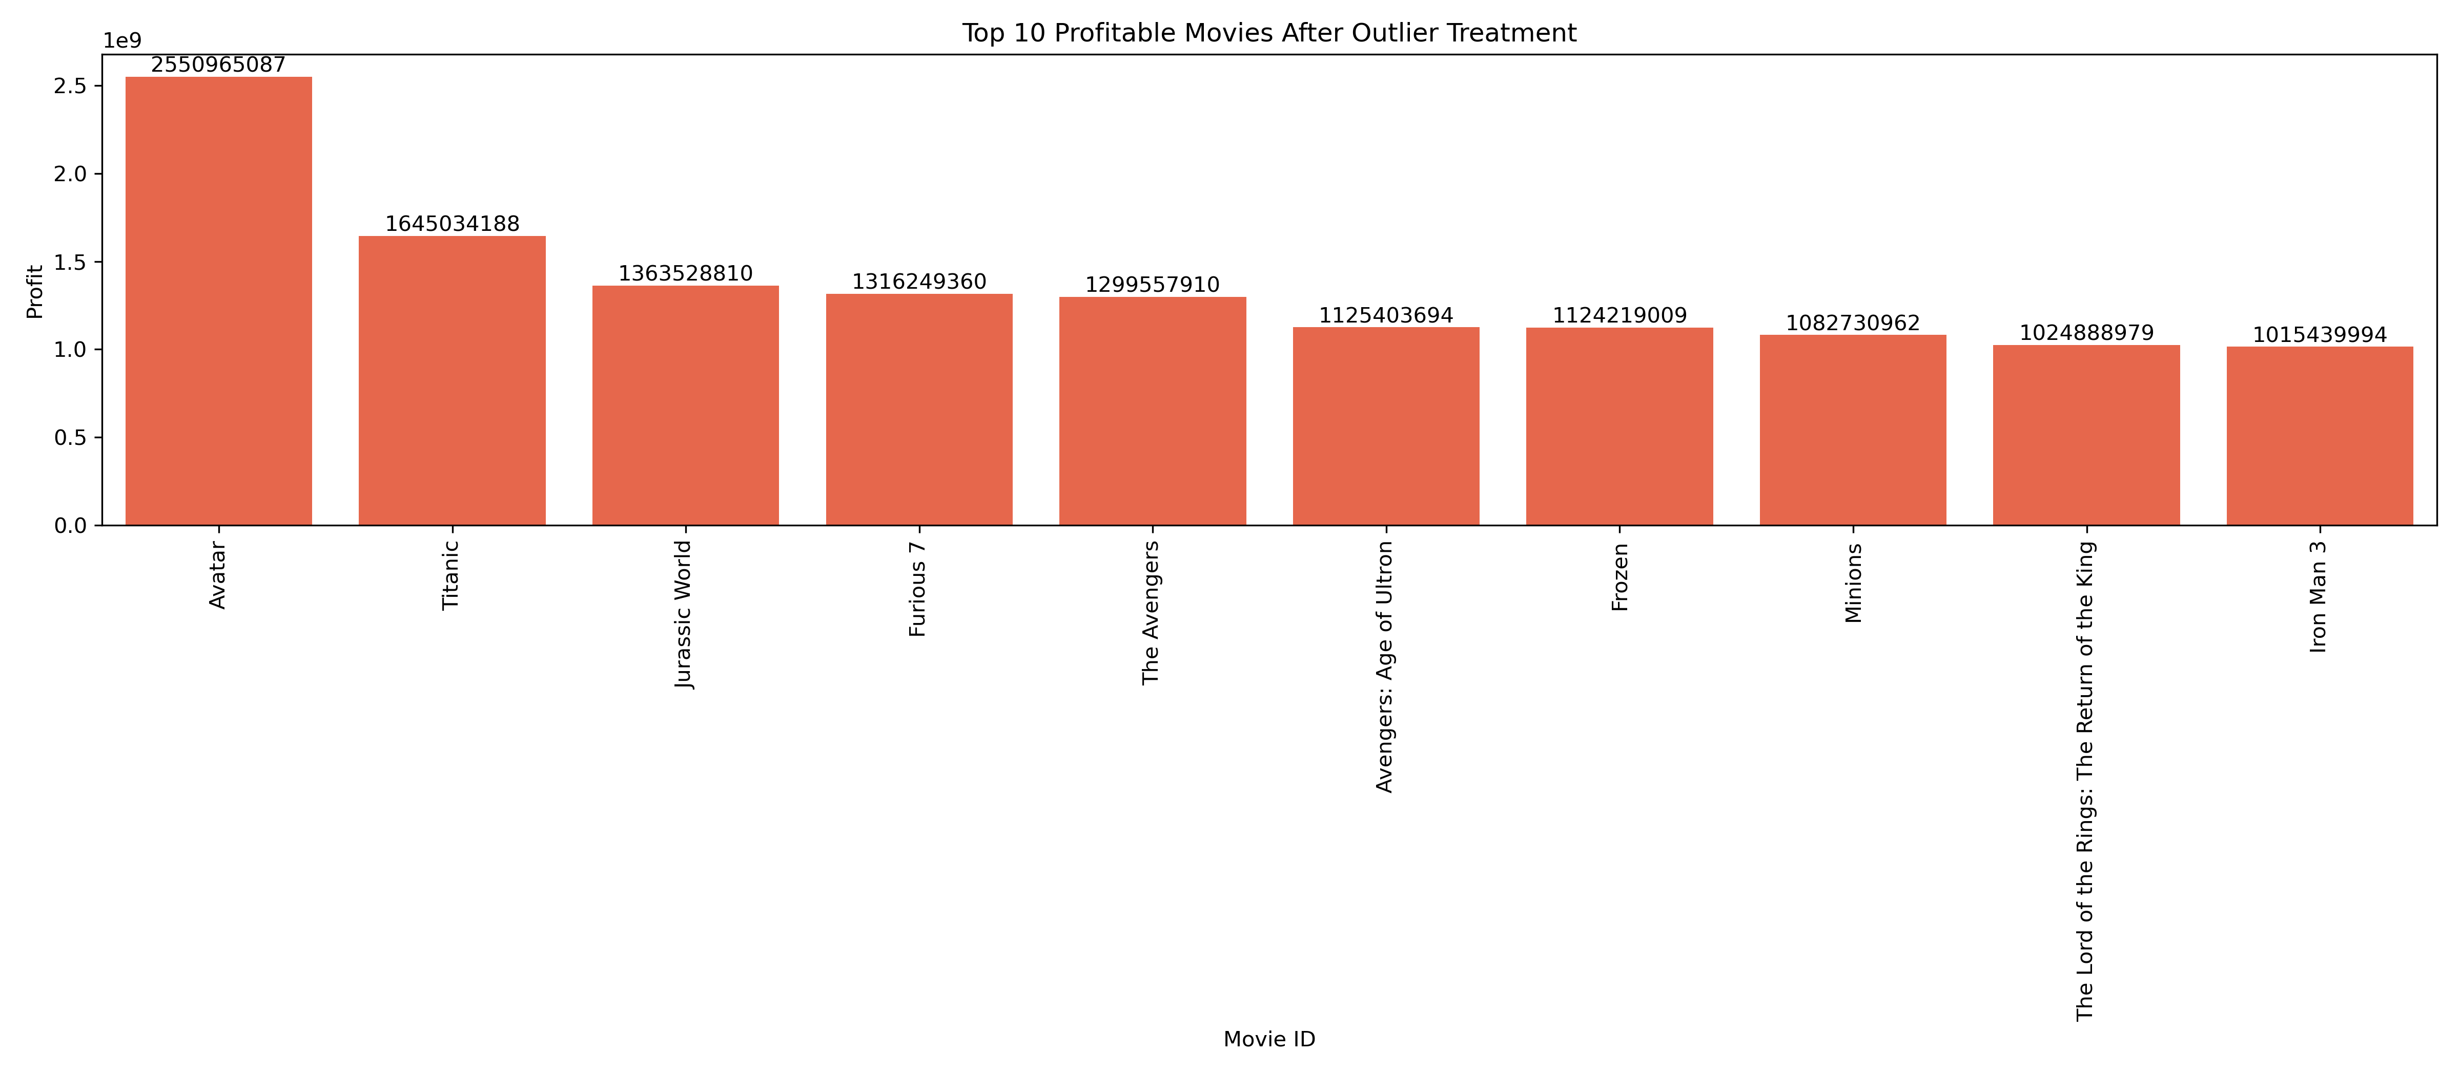
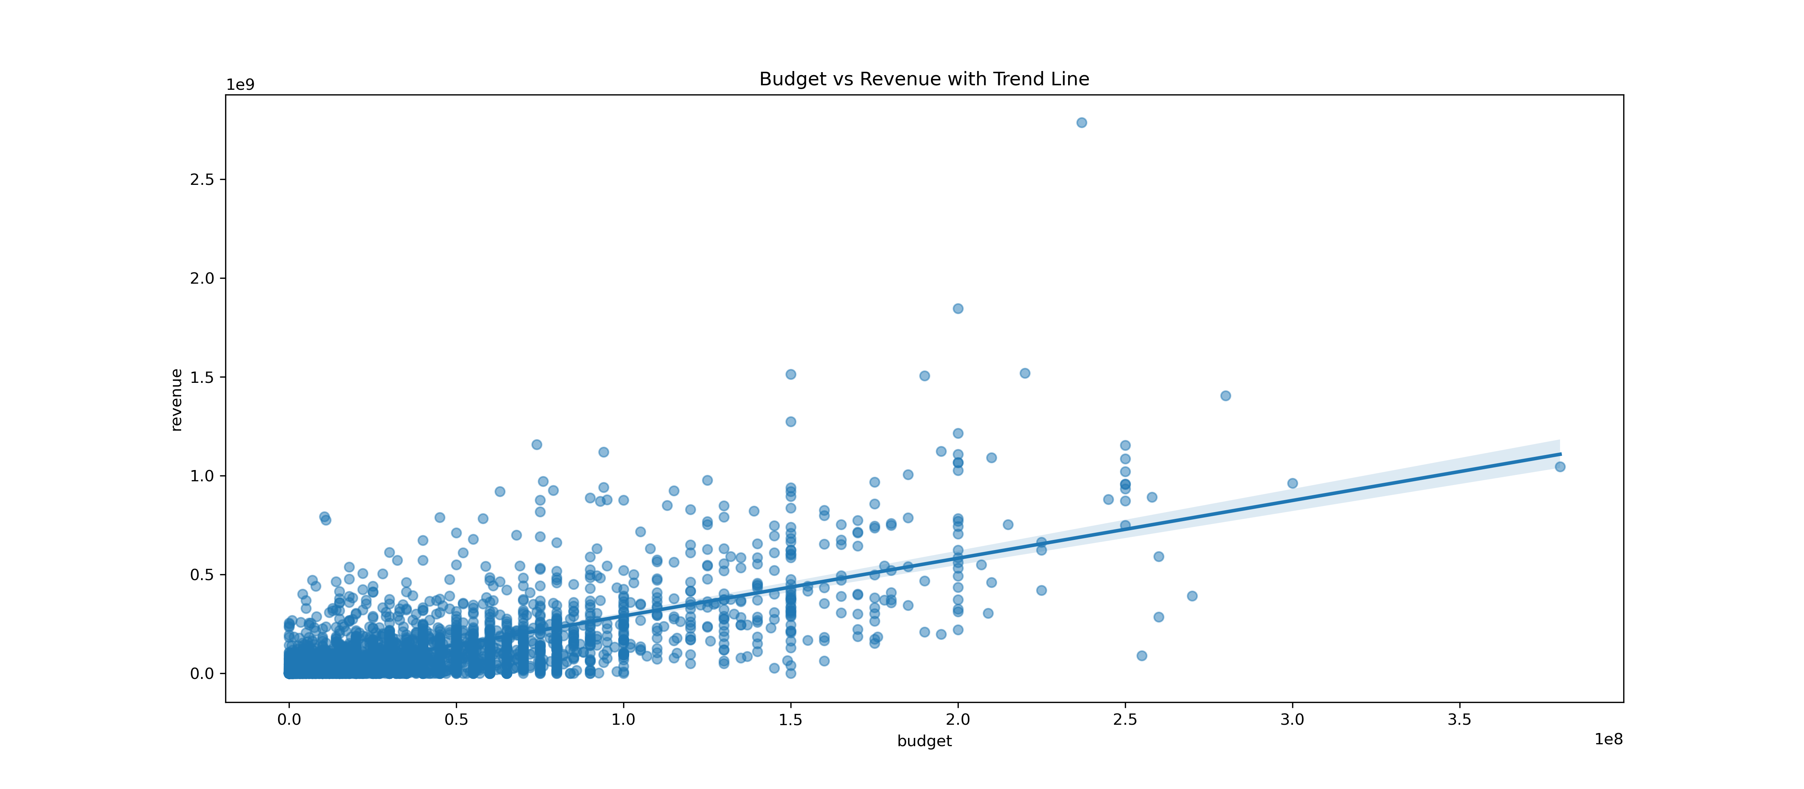
FOCUS AREA 1: Movie Performance Analysis
Objective A:
Objective B:
To support strategic film production decisions by analyzing which films generate the highest returns, what genres perform best financially, and what budget levels are associated with maximum profitability.
Examine how budget influences a movie’s financial return
What is the relationship between budget and box office revenue?
Are there budget thresholds where ROI (Return on Investment) is maximized ?
Which movies have generated the highest profit?
What genre do these high-profit movies belong to?

Slide 7
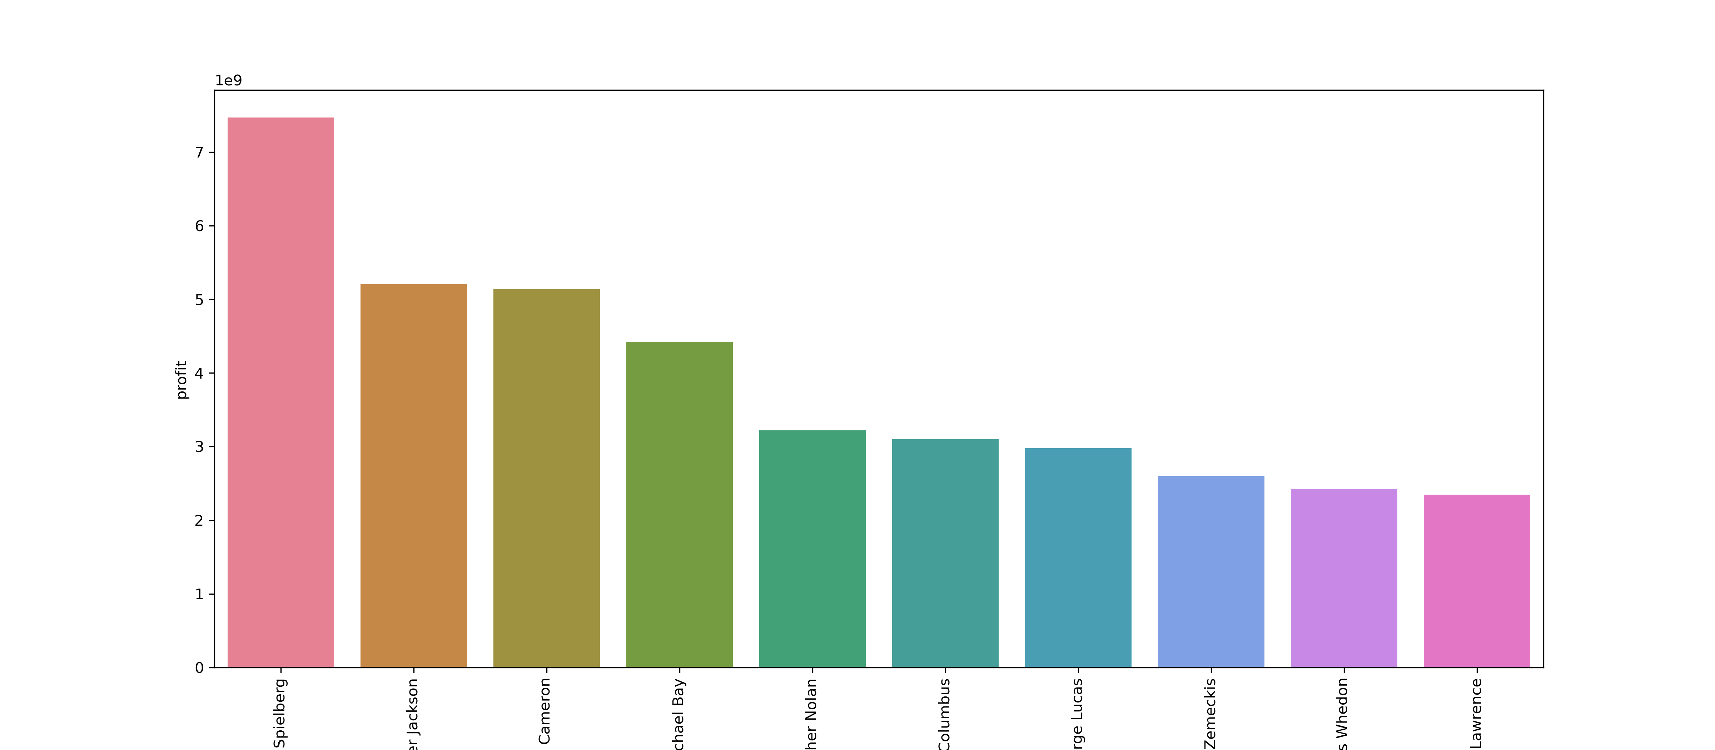
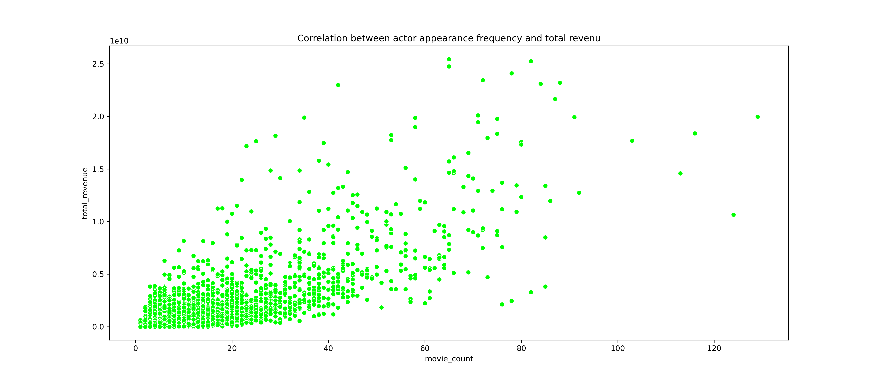
FOCUS AREA 2: CAST & CREW IMPACT
Objective A:
Objective B:
To evaluate how directors influence movie success by analyzing their total profit, genre focus, and audience ratings
Analyze how lead actors affect movie revenue, genre profitability, and performance frequency impact.
Which directors have generated the most total profit?
Are their movies consistently well-rated by audiences
How do lead actors influence movie success?
Is there a correlation between actor appearance frequency and revenue?

Slide 8
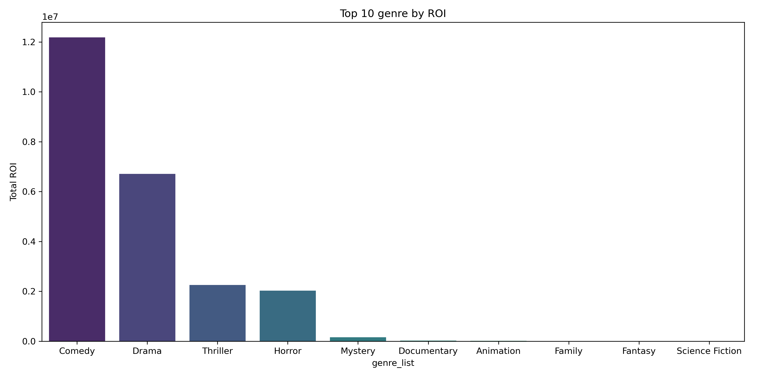
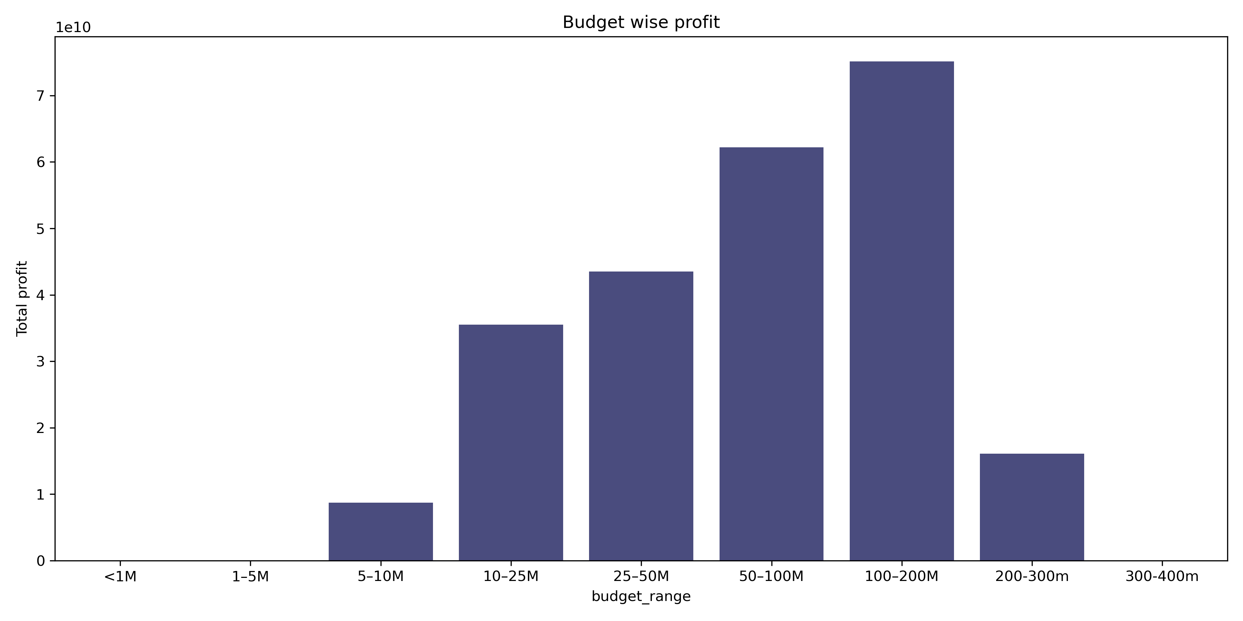
FOCUS AREA 3: BUDGET ALLOCATION & PROFITABILITY
Objective A:
Objective B:
Evaluate ROI across budget categories to identify which budget levels and genres yield the highest profitability.
Analyze the profitability of high-budget films and identify budget ranges that offer the best balance between total profit and ROI
What is the typical ROI across different budget categories?
Which budget level delivers the best ROI by genre
Are high-budget films always more profitable
Which budget range yields the best balance between total profit and ROI?

Slide 9
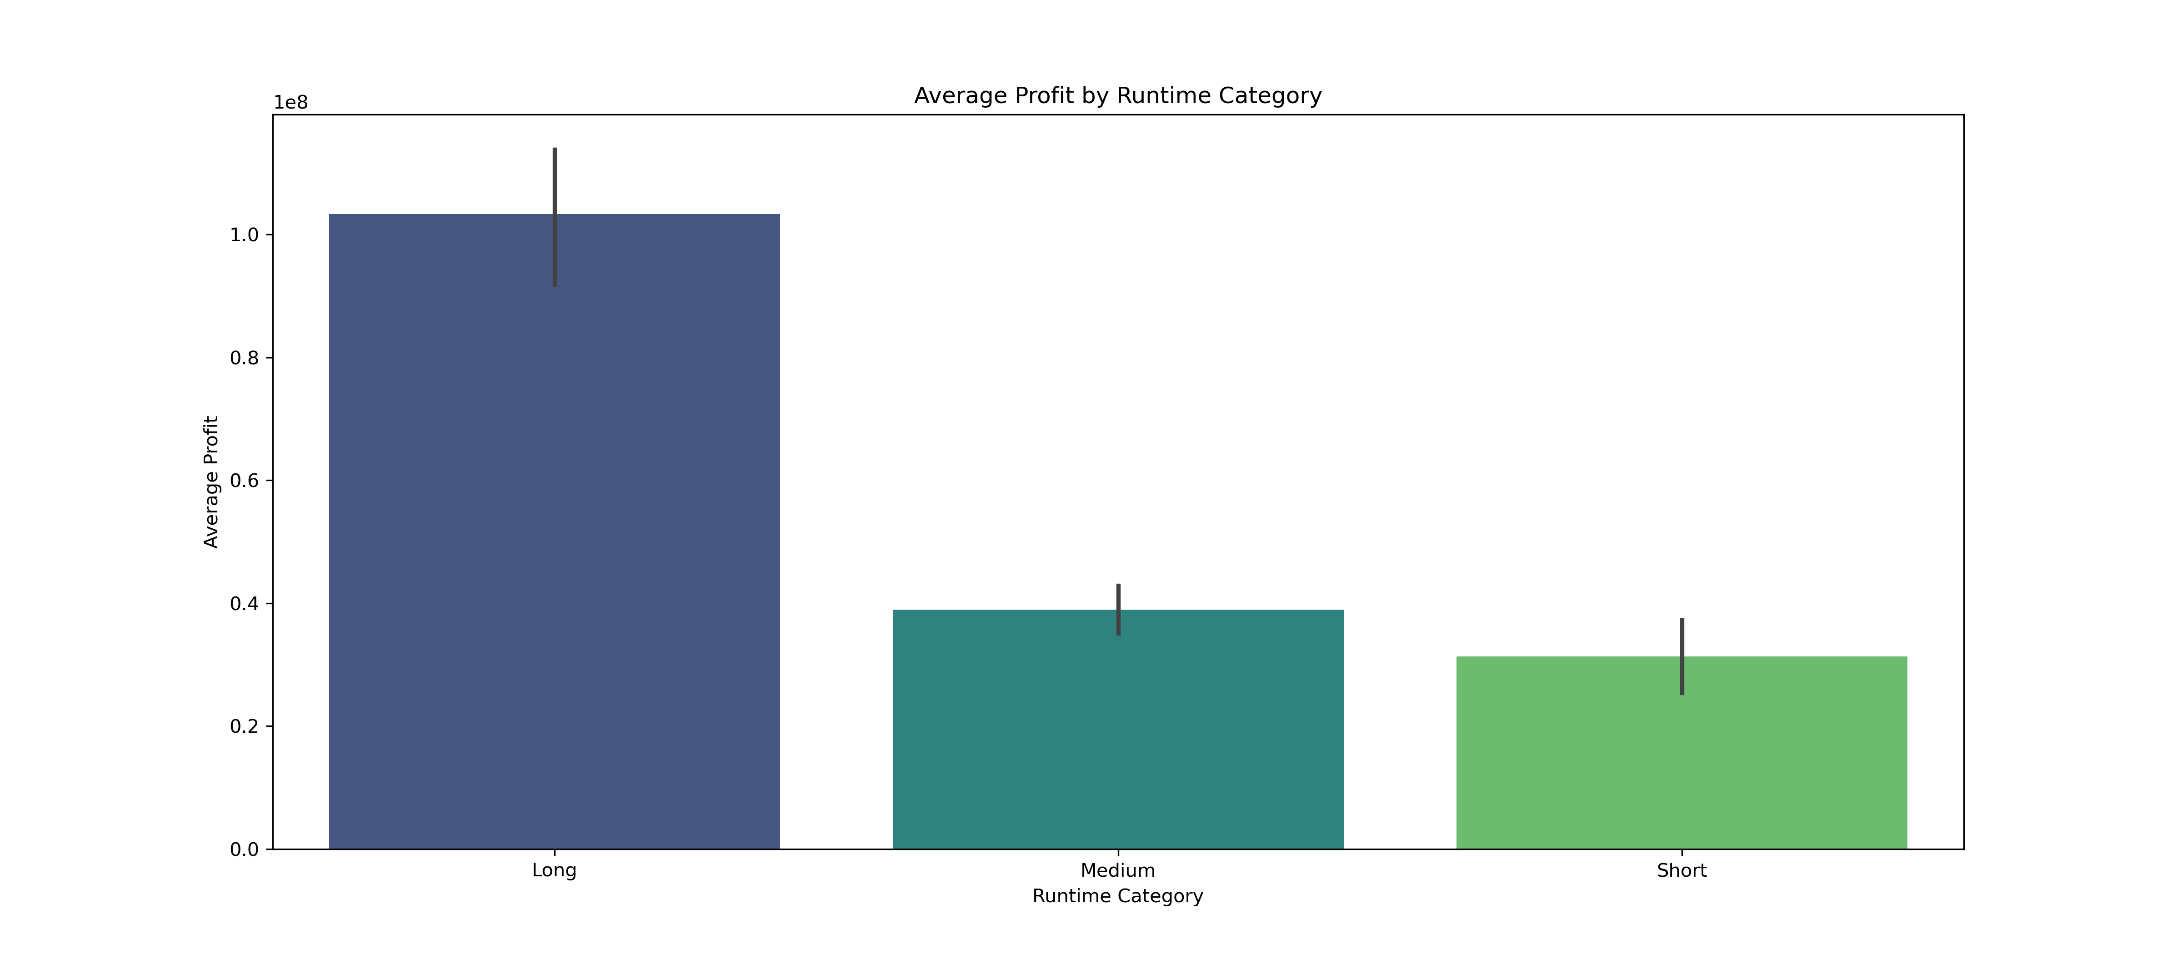
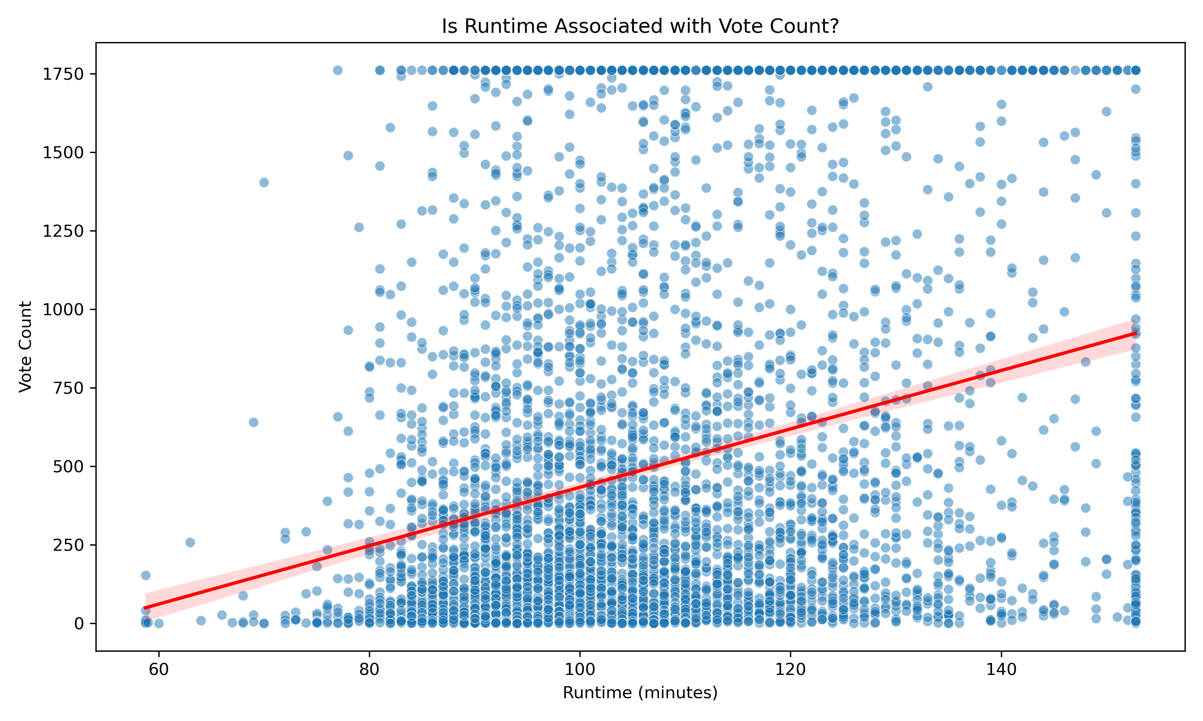
FOCUS AREA 4: RUNTIME & CONTENT STRATEGY
Objective A:
Objective B:
To identify the optimal runtime for maximizing movie profit, assess how it varies across genres, and evaluate the performance of movies with extreme runtimes
To evaluate how movie runtime influences audience ratings and engagement by analyzing its correlation with vote averages and vote counts
What is the ideal runtime range for high-profit movies
How do extremely short or long movies perform?
Is there a correlation between runtime and audience ratings?
Do longer movies get higher or lower vote averages?

Slide 10
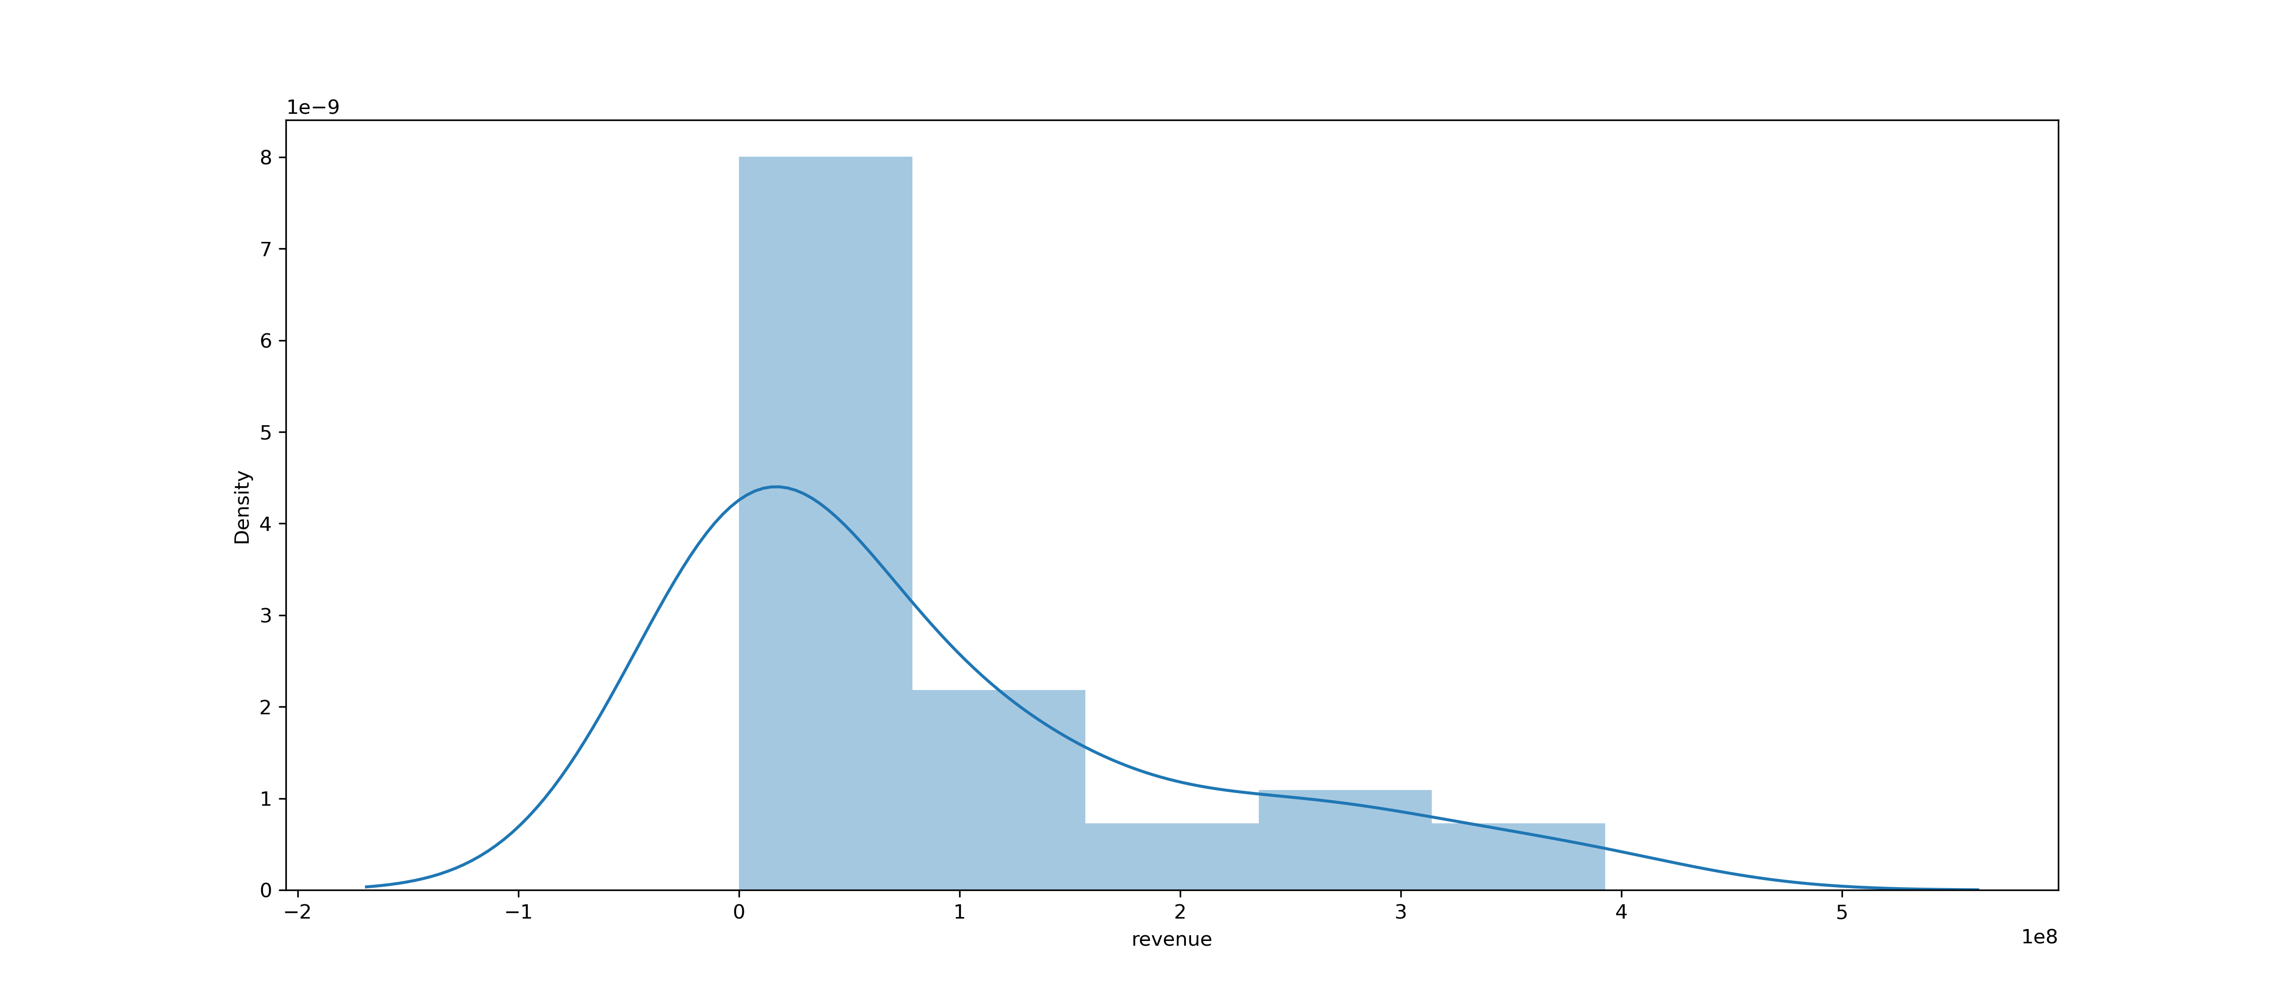
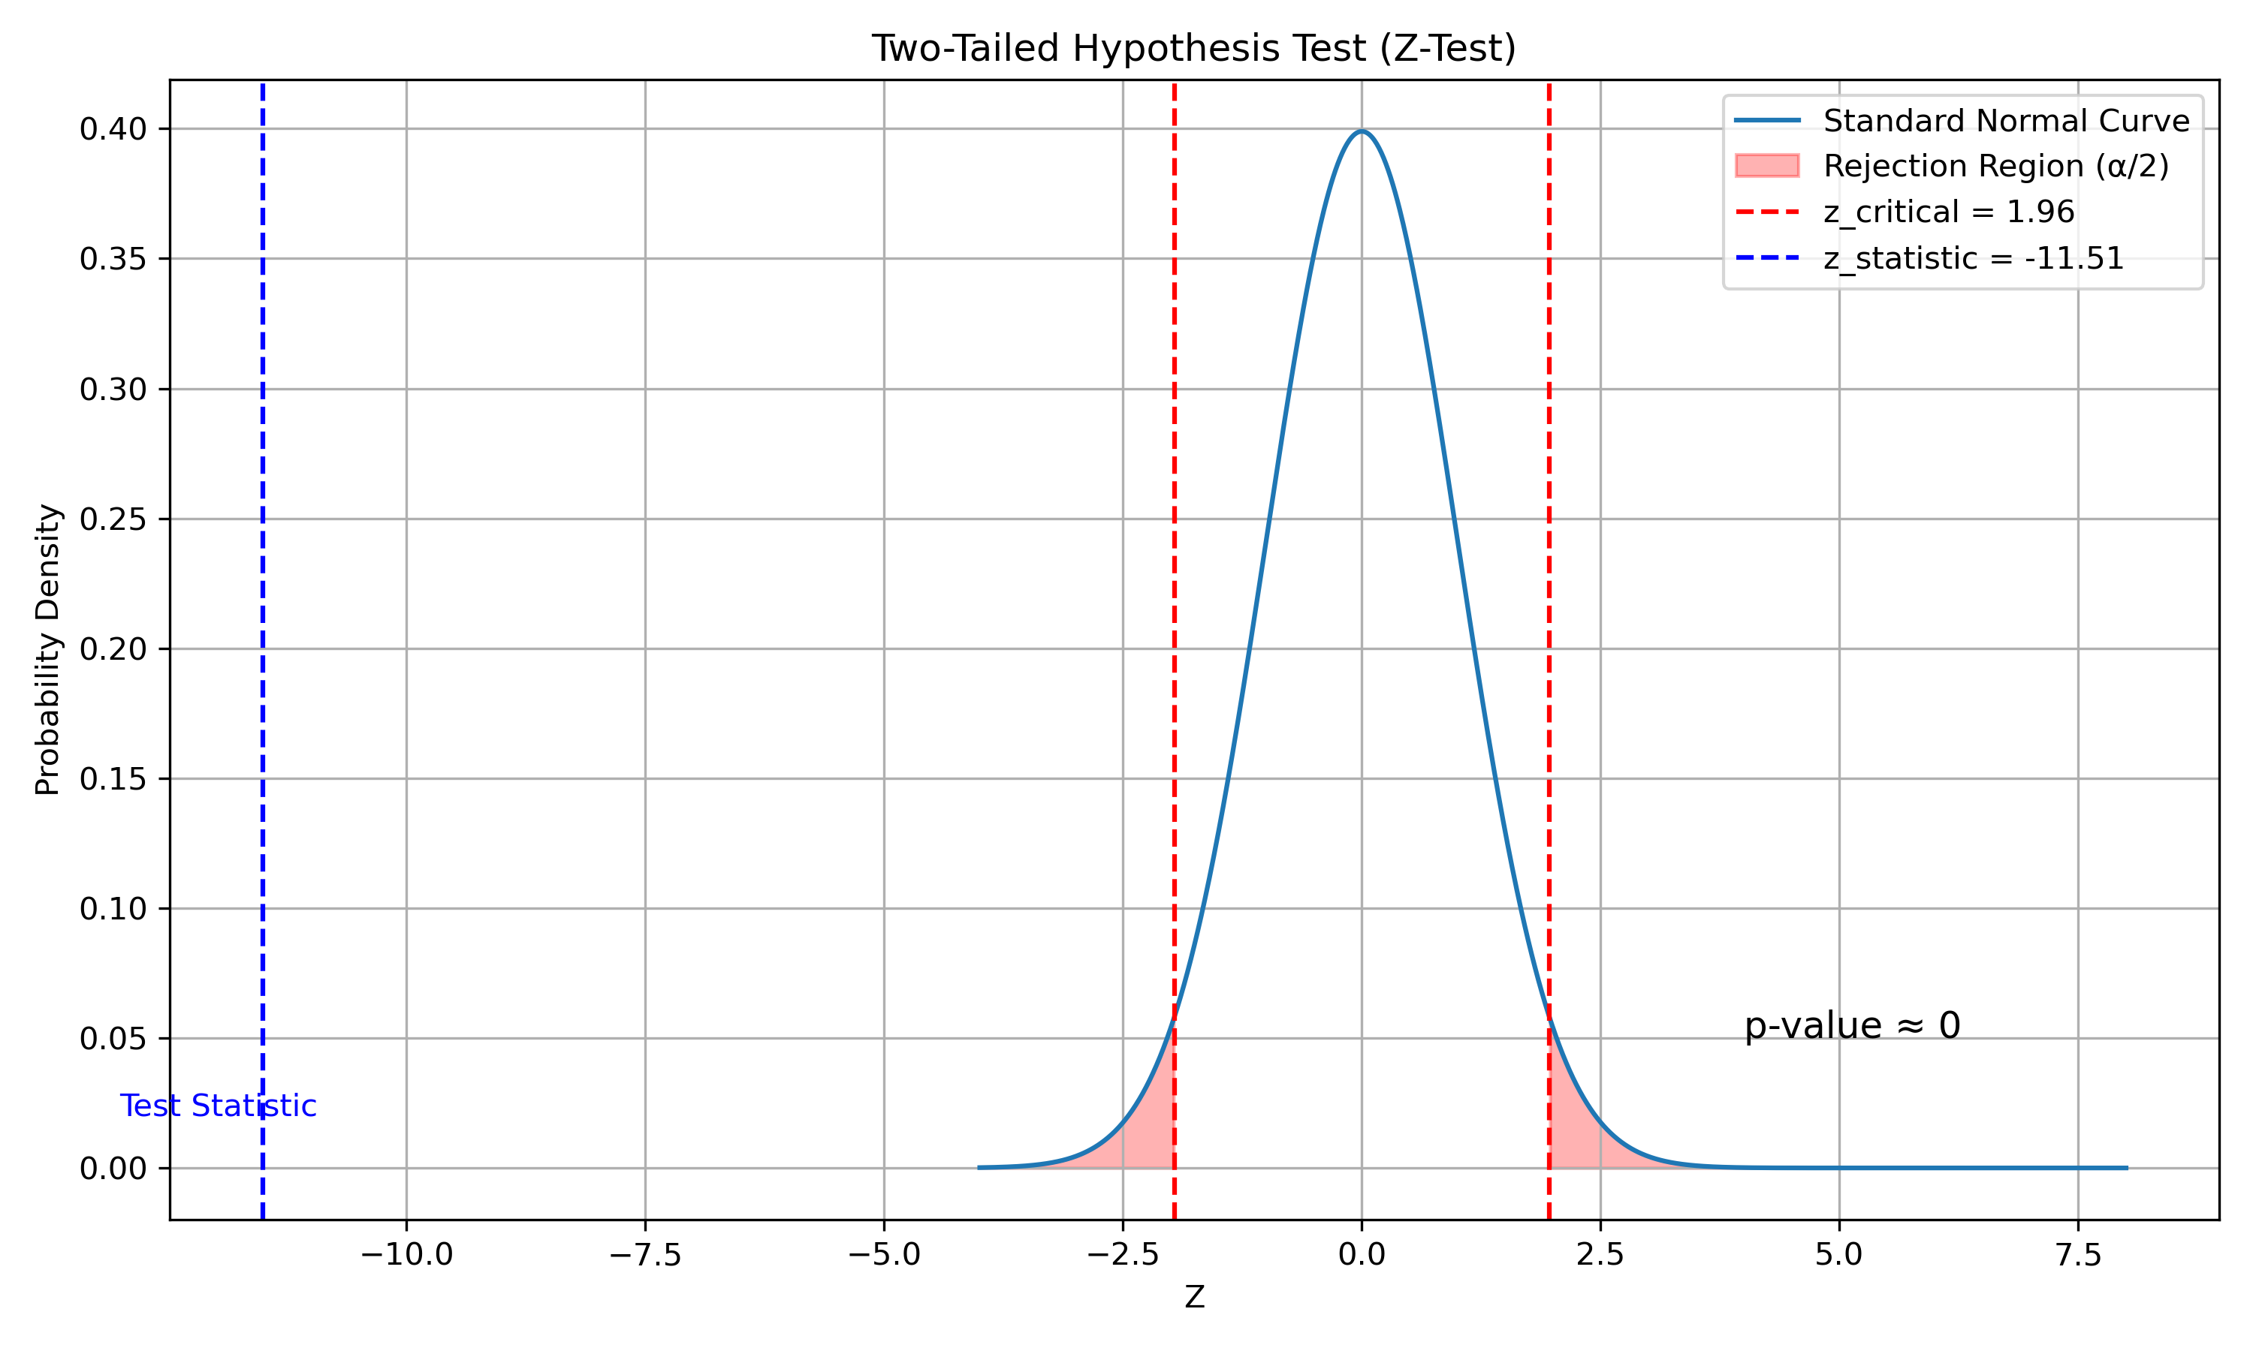
FOCUS AREA 5: Statistical Analysis
Objective A:
Objective B:
To apply statistical methods to evaluate movie performance, including estimating average revenue through sampling and assessing the likelihood of high revenue within specific genres like Action
To use statistical tests to validate assumptions about movie budgets and audience ratings, including hypothesis testing on average budgets and assessing the normality of vote averages.
Hypothesis Testing with Z-Test: Test if the average movie budget is significantly different from $100M.
Normal Distribution and Movie Ratings: Assess if the distribution of movie vote averages follows a normal distribution
Find the conditional probability that a movie will have a revenue above $500M given that it belongs to the "Action" genre.
Estimate the average revenue of movies in the dataset using sampling techniques.

Slide 11
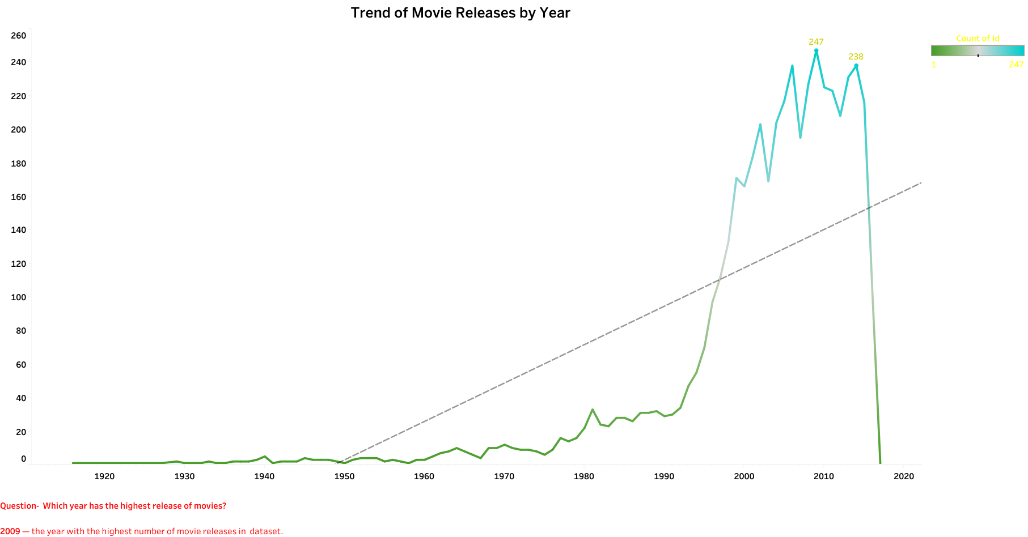
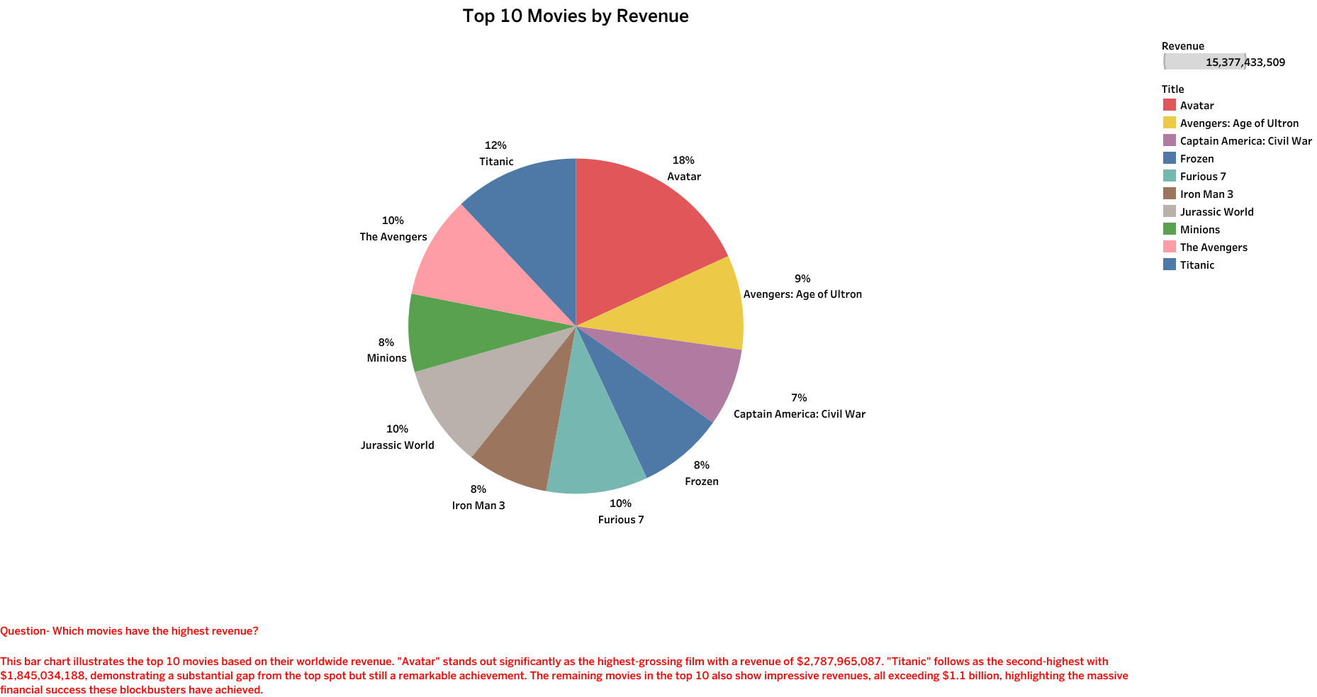
FOCUS AREA 6: RELEASE TRENDS & PROFIT INSIGHTS
Objective A:
Objective B:
To analyze yearly movie release patterns and identify the most and least profitable films, offering insights into market trends and performance extremes
To identify the top-performing movies in terms of budget and revenue, providing insights into high-investment and high-earning productions
Which movies have the highest budget?
Which movies have the highest revenue?
Which year has the highest release of movies?
Which movies have the highest profits?

Slide 12
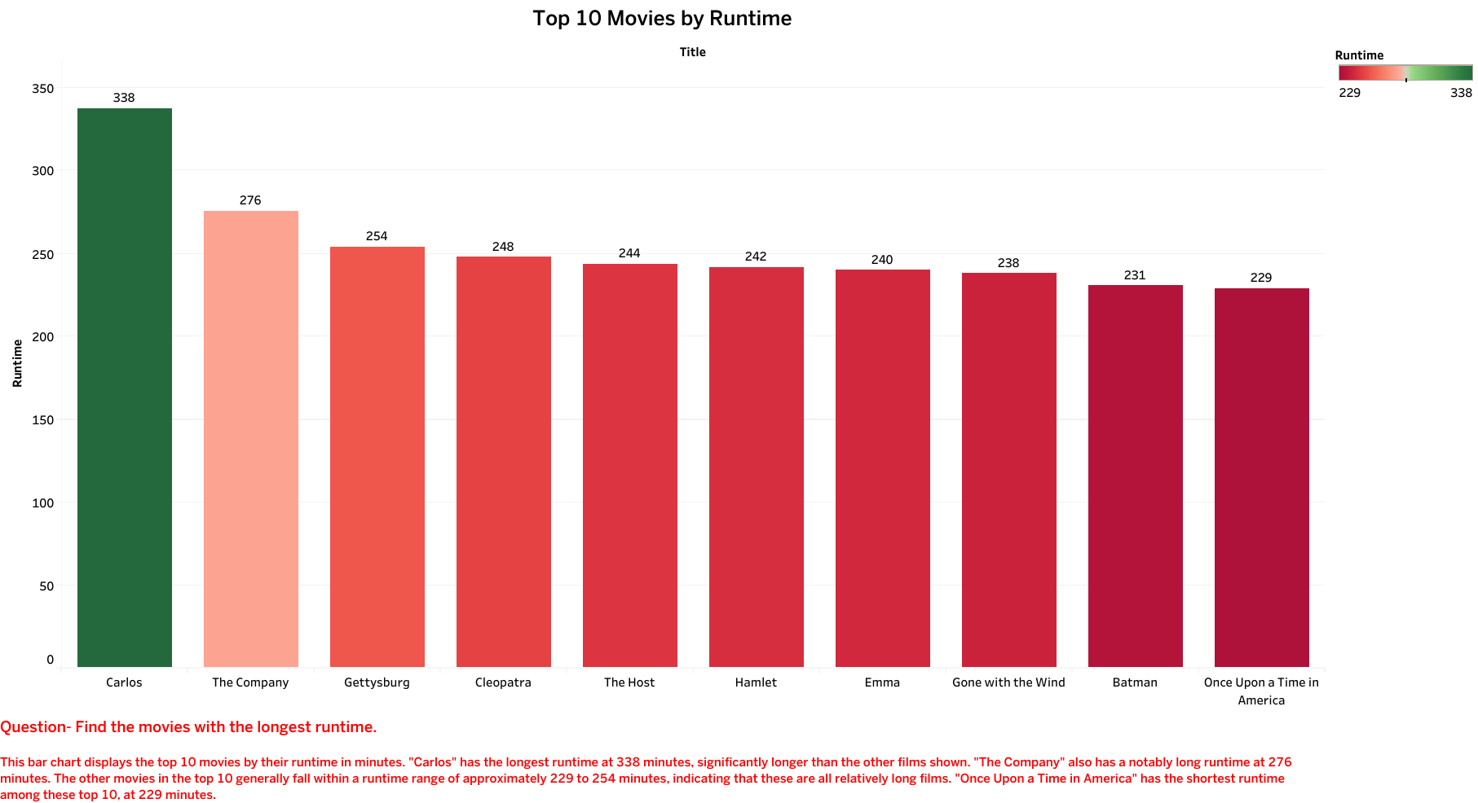
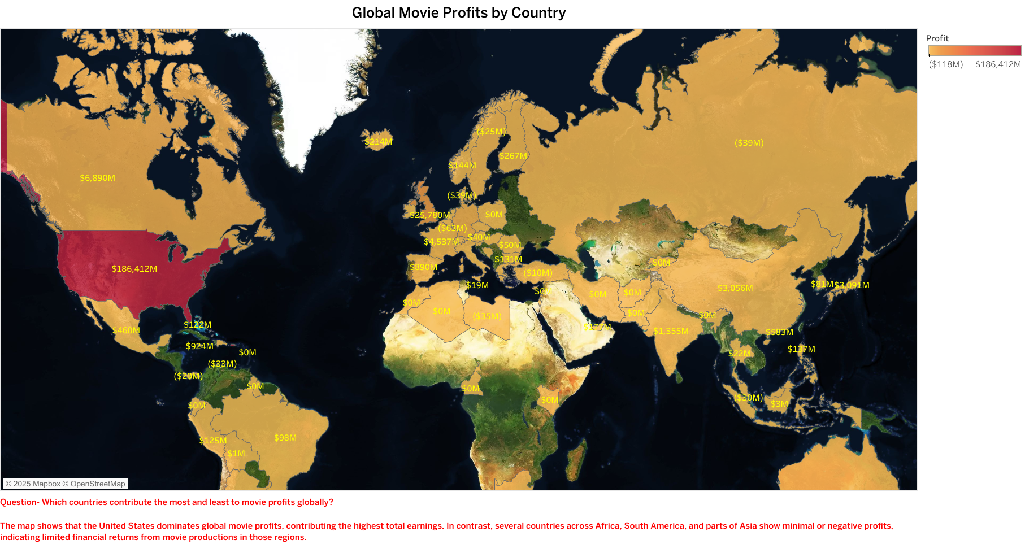
FOCUS AREA 7: Profitability and Runtime Analysis in Global Movie Industry
Objective A:
Objective B:
To explore how runtime and release timing impact movie profitability by identifying the longest films and analyzing which months yield the highest average profit.
To analyze the relationship between movie budgets and profits, and to identify global profit contributions by country, highlighting the top and bottom-performing regions
What is the relationship between a movie's budget and its profit?
Which countries contribute the most and least to movie profits globally?
Find the movies with the longest runtime.
Which month provides a high rate of profit (on average) made a business objective

Slide 13
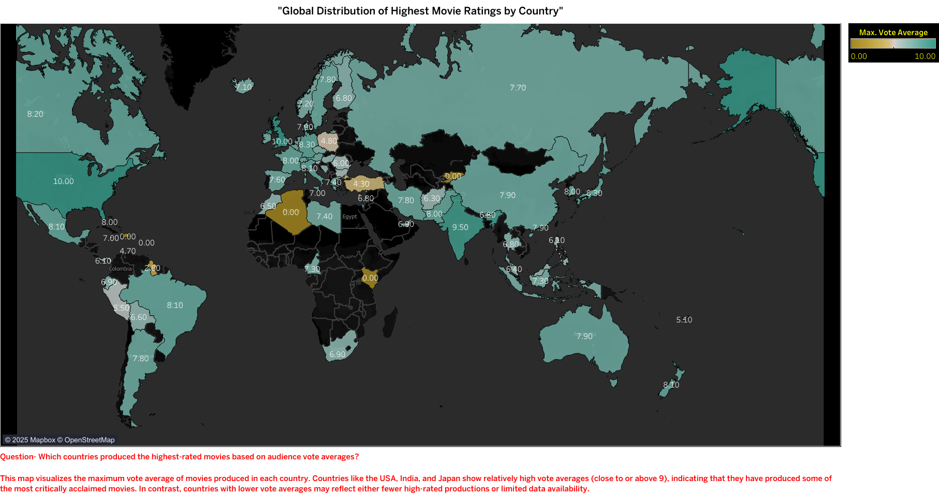
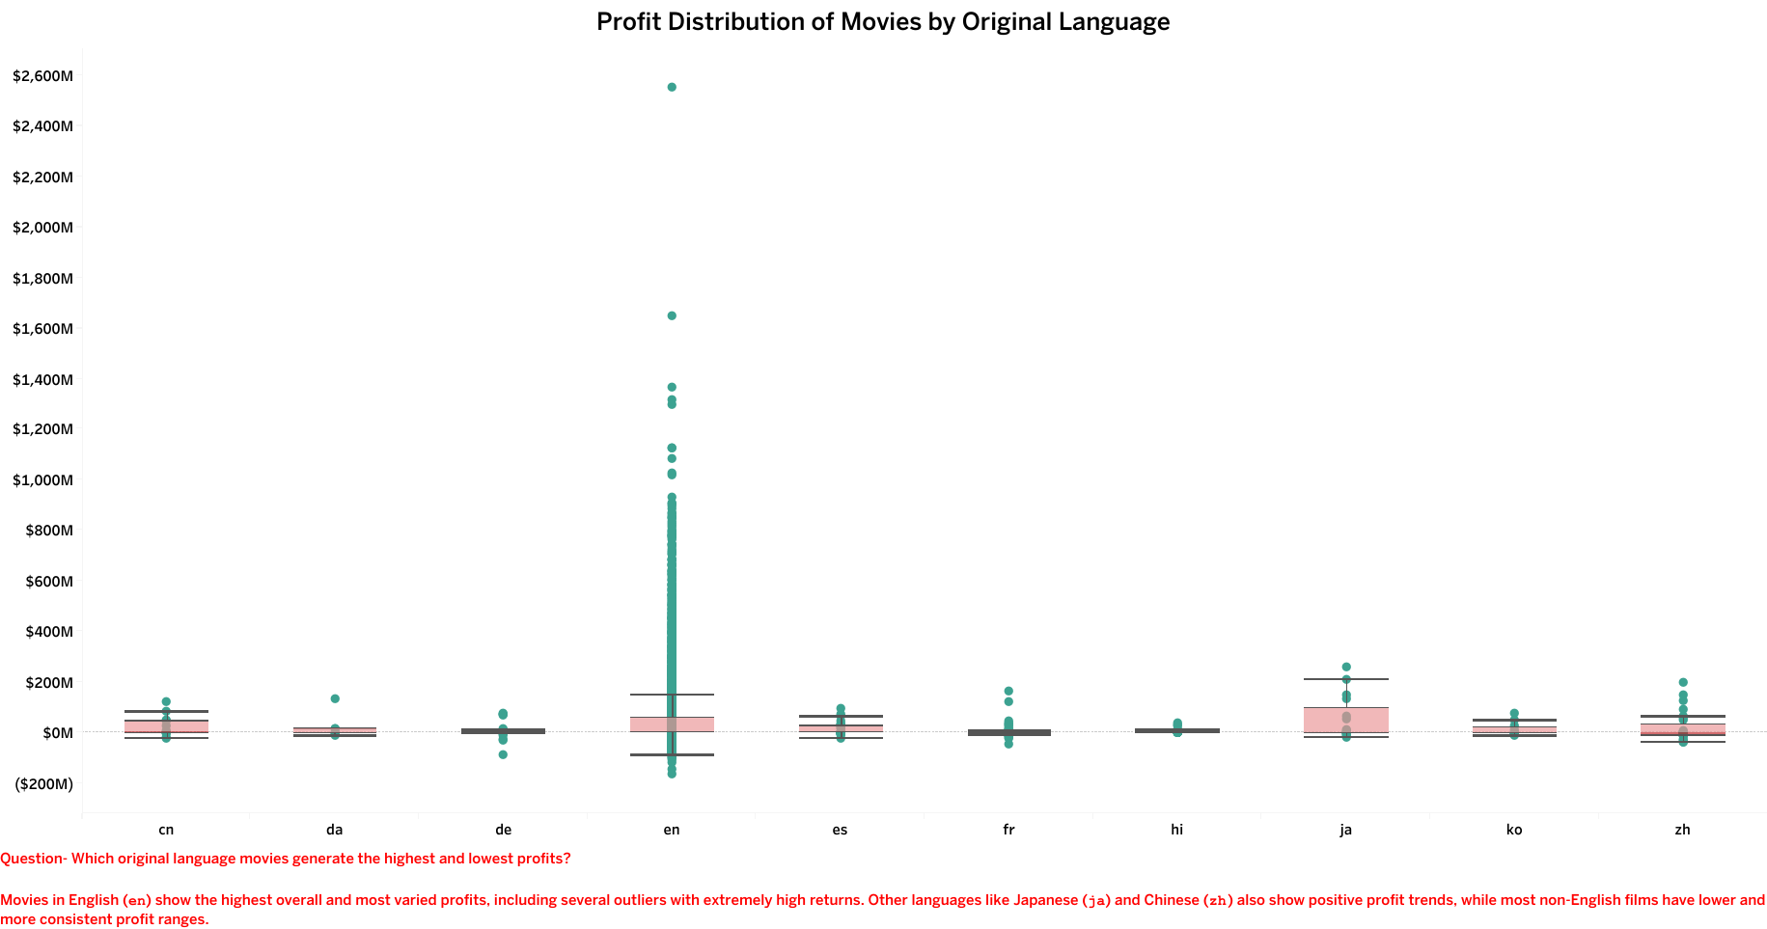
FOCUS AREA 8: Country, Language, Budget, and Genre Insights in Movie Success
Objective A:
Objective B:
To identify countries producing the highest-rated movies and determine which films (by ID) have the highest average budgets and profits
To evaluate profit performance across original languages and identify the most frequently released movie genres in the dataset.
Which original language movies generate the highest and lowest profits?
Which genres have the highest release of movies? made a business objective?
Which countries produced the highest-rated movies based on audience vote averages?
Which movies (by ID) have the highest average budgets and profits?

Slide 14
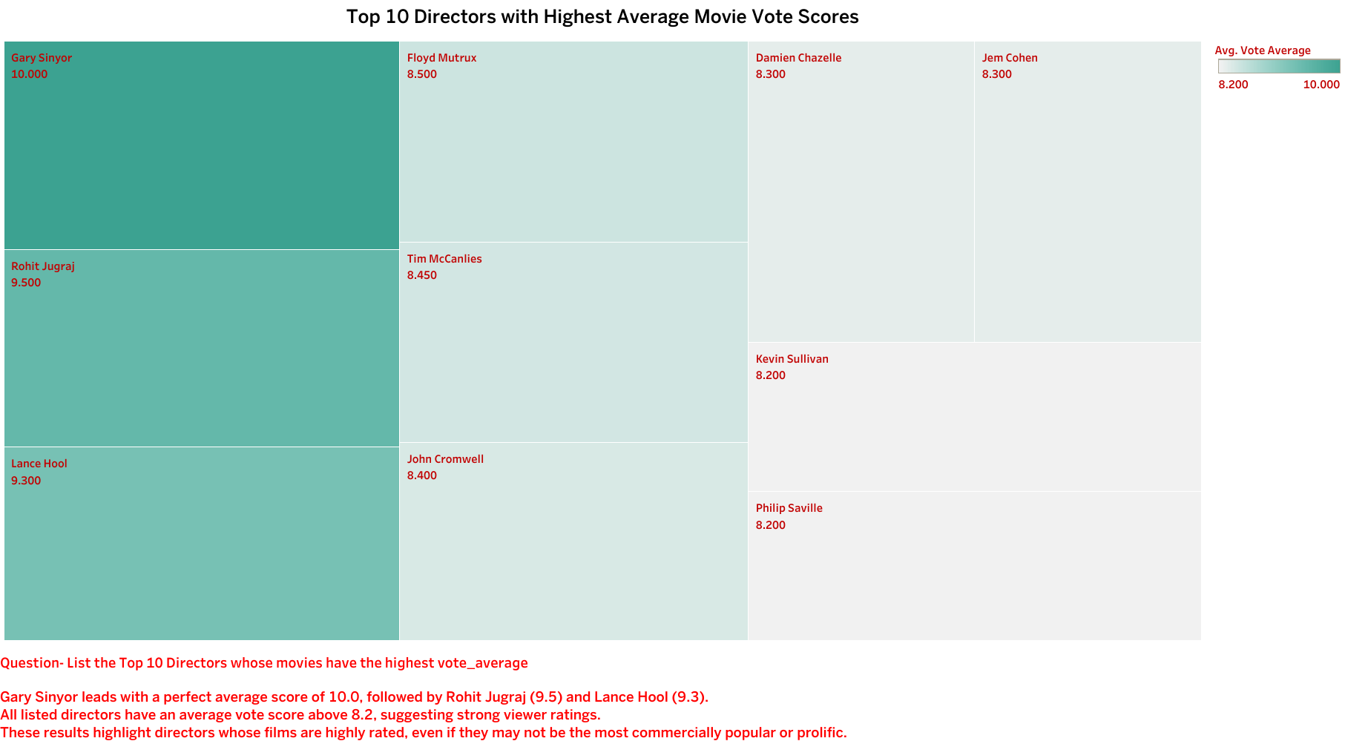
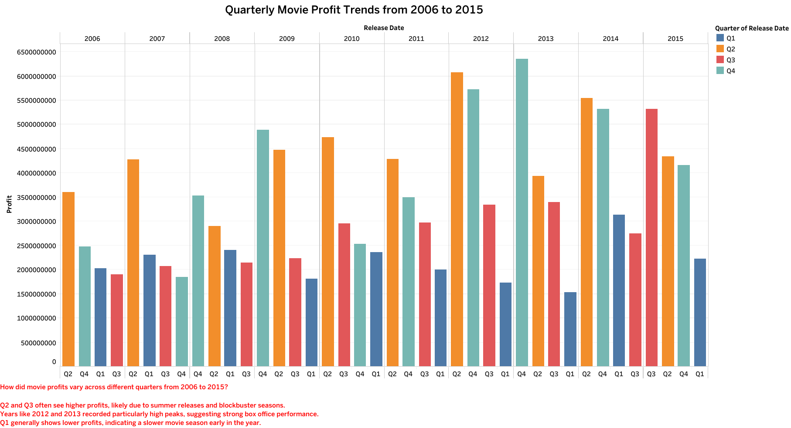
FOCUS AREA 9: Understanding Movie Success Through Direction, Profitability, Release
Objective A:
Objective B:
To identify top-performing directors based on audience ratings (vote average) and to analyze the overall distribution of movie profits to understand profitability trends across different profit ranges.
To analyze the distribution of movies across different release statuses and evaluate how movie profits fluctuated across different quarters from 2006 to 2015, in order to identify release patterns and seasonal trends that influence profitability.
List the Top 10 Directors whose movies have the highest vote_average.
What is the distribution of movie profits, and how many movies fall within each profit range?
What is the distribution of movies across different release statuses?
How did movie profits vary across different quarters from 2006 to 2015?

Slide 15

FOCUS AREA 10 : Machine Learning
Model – 1 K-Nearest Neighbor Algorithm
Model – 2 Linear Regression Algorithm
Topic- Movie Rating prediction
Topic- Revenue prediction
Steps - Encoding with categorical column, log transformation for outliers, Make a Target Column, Features scaling with Standard Scaler, Feature Selection- Detect multicollinearity, Data splitting, Build Model , Model Evaluation.
Steps - Encoding with categorical column, log transformation for outliers, Features scaling with Standard Scaler, Feature Selection- Detect multicollinearity, Data splitting, Build Model , Model Evaluation.
Model Accuracy is 75% and f1_score is 74 %
R2_Score is 60% and mean absolute error is 3%
Recall is 75% and Precision 74.3%
Mean squared error is 26% and mean squared error is 5%
The model is extremely accurate in predicting high-rated and Poor –rated movies.
Business Interpretation
Access Link
1. ROI Estimation: Predicts financial return to help plan profit margins.
2. Budget Optimization: Helps studios adjust budgets according to expected returns.
3. Investor Pitching: Use revenue projections to attract investors and distributors.
4. Risk Assessment: Identify financially risky projects early in development.
https://movie-rating-predictor-n7eg.onrender.com/
Business Interpretation
1. Greenlight Decisions: Studio executives can use early predictions to greenlight only promising scripts.
2. Budget Planning: Allocate higher budgets to movies with high predicted ratings.

Slide 16
FOCUS AREA 10 : Machine Learning
Model – 3 Logistic Regression Algorithm
Model – 4 K-Means clustering Algorithm
Topic- Genre prediction
Topic- Find patterns in the top-rated movies
Steps - Encoding with categorical column, log transformation for outliers, Features scaling with Standard Scaler, Feature Selection- Detect multicollinearity, Data splitting, Build Model , Model Evaluation.
Steps - Encoding with categorical column, log transformation for outliers, Features scaling with Standard Scaler, Feature Selection- Detect multicollinearity, Elbow method/Silhouette score , Build Model , Model Evaluation.
Model Accuracy is 35% and f1_score is 53 %
Silhouette score is 0.11 with k value 7
Recall is 70% and Precision 67%
Calinski Harabasz Index is 34.38 and Davies-Bouldin index 1.95
Drama has the best performance, Comedy, Thriller and Action perform moderately well
Business Interpretation
Business Interpretation
Content Strategy: Helps in identifying key success factors (e.g., high budget, famous director, genre diversity).
Talent Acquisition: Spot clusters with high-performing directors and actors to replicate success.
Genre Trends: Find genre combinations that appeal to broader audiences.
Cluster 3 emerged as the Gold Standard group
1. Automation of Metadata: Speeds up genre tagging for streaming platforms and movie databases.
2. Knowing a movie's genre early helps design targeted promotions and trailers suited for specific viewer segments (e.g., action lovers vs. romance lovers)
3. Platform Curation: Streaming services can recommend or group movies based on predicted genre.

Slide 17
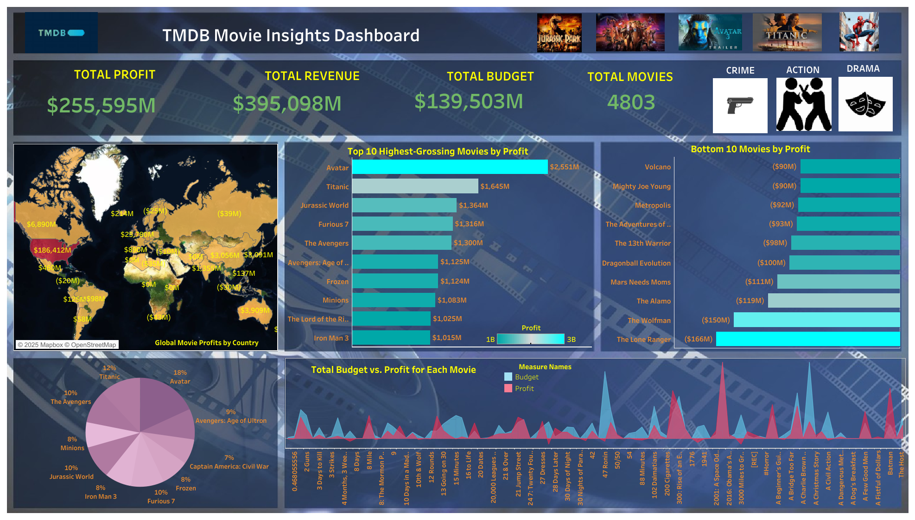

Slide 18
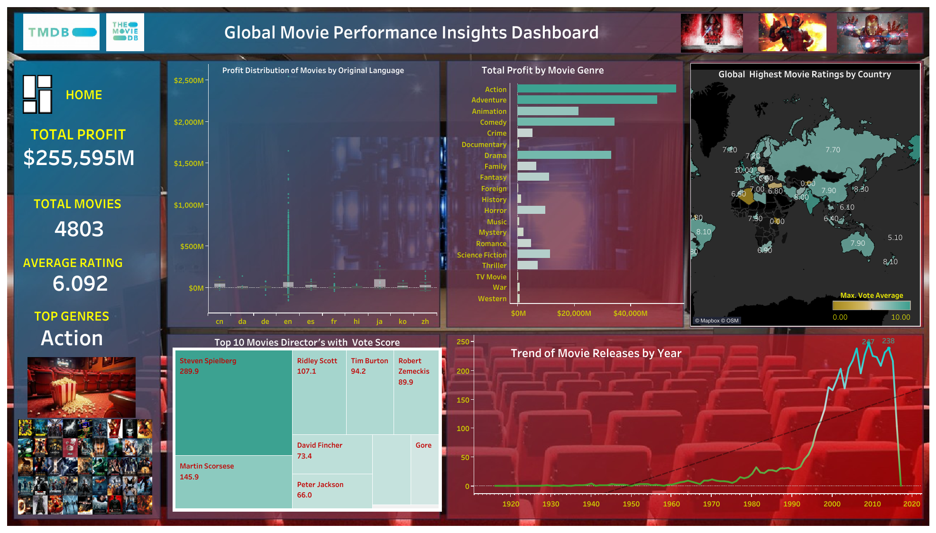

Slide 19


Business Implementation of <<ML>> Model
Model 1: Movie Rating Prediction - To predict whether a movie will be highly rated and commercially successful.
Key Business Benefits:- 1. Greenlight Decisions: Studio executives can use early predictions to greenlight only promising scripts.
2. Budget Planning: Allocate higher budgets to movies with high predicted ratings.
3. Marketing Strategy: Focus promotional resources on movies predicted to perform well.
Real-world Impact: Model Accuracy: 79% Predicting successful movies at the pre-production stage reduces investment risks and boosts ROI.
Model 2: Revenue Prediction- To estimate the expected revenue a movie will generate based on features like budget, genre, popularity, etc.
Key Business Benefits:- 1. ROI Estimation: Predicts financial return to help plan profit margins.
2. Budget Optimization: Helps studios adjust budgets according to expected returns.
3. Investor Pitching: Use revenue projections to attract investors and distributors.
Real-world Impact: R² Score: 60% Provides strong forecasting for medium-budget films and supports more informed financial decisions.
Model 3: Genre Categorization :- To automatically categorize movies into genres based on available features.
Key Business Benefits:- 1. Automation of Metadata: Speeds up genre tagging for streaming platforms and movie databases.
2.Targeted Marketing: Helps in tailoring trailers and promotions to specific audience segments.
3.Platform Curation: Streaming services can recommend or group movies based on predicted genre.
Real-world Impact: Model Accuracy: 36% Despite moderate performance, it adds value in early content pipeline stages for content distributors and OTT platforms.
Model 4: Top-Rated Movie Clustering- To identify hidden patterns and group characteristics in top-rated movies.
Key Business Benefits:- Content Strategy: Helps in identifying key success factors (e.g., high budget, famous director, genre diversity).
Talent Acquisition: Spot clusters with high-performing directors and actors to replicate success.
Genre Trends: Find genre combinations that appeal to broader audiences. .. Cluster 3 emerged as the Gold Standard group.

Slide 20


Summary
The dataset contains records of around 4803 Movies.
English (en) language dominates the dataset with 4,503 movies, making up the vast majority of the entries.
Avatar" stands out as the most profitable movie with a profit of over $2.5 billion, significantly exceeding other films on the list.
Adventure leads with the highest total profit ($1.12 trillion), followed by Action ($1.03 trillion), These genres are likely the most commercially viable and attract large-scale audiences.
$ 92281437.47 the average budget range for these high-profit films.
make a Note - a higher budget does not always result in higher revenue. Higher budget increases the potential for higher revenue, but it doesn't guarantee it. Success still depends on content quality, timing, audience connection, and competition.
Steven Spielberg is the most profitable director by a significant margin, with earnings exceeding 7 billion. Peter Jackson and James Cameron follow, each with profits above 5 billion. most top profitable directors consistently deliver well-rated movies.
Tom Cruise leads with $9.33B total profit from 78 movies - showing a consistent high-profit record. Brad Pitt and Cameron Diaz follow closely, both contributing over $8B.Tom Cruise and Will Smith have the highest average profit per film (~$119M) .
91 to 153 minute is the ideal runtime range for high-profit movies. longer movies tend to earn more, be more popular, and get better reviews.
2009 - the year with the highest number of movie releases and movies released in May and November tend to have the highest average profits and Q2 and Q3 often see higher profits, Years like 2012 and 2013 recorded particularly high peaks, suggesting strong box office performance.
The United States appears to be the dominant country in terms of movie profits, with an indicated profit of $186,412M. Other countries show varying levels of profit, with some displaying significant figures like Russia ($2,720M) and China ($3,056M), while many others have lower or negative profits

Slide 21
Conclusion
In conclusion, the movie dataset offers valuable insights into genre profitability, director and actor performance, budget-revenue dynamics, release timing, and geographical influence. These insights can support data-driven decisions in film production, marketing strategies, and investment planning, ultimately contributing to more successful outcomes in the movie industry.
Key Insights from Movie Data Analysis
Language Preference: Focus on English-language films, as they dominate the global market with over 4,500 titles in the dataset.
High-Profit Genres: Adventure and Action films generate the highest total profits—ideal for attracting wide audiences and global reach.
Smart Budgeting: While high-budget films (avg. $92.28M) often yield higher profits, budget alone doesn't guarantee success. Strategic allocation matters.
Proven Talent: Partnering with directors like Steven Spielberg and actors like Tom Cruise or Will Smith—who have consistent profit records—can boost success.
Optimal Runtime: Aim for runtimes between 91–153 minutes, the sweet spot for audience engagement and profitability.
Release Timing: Schedule film releases in May or November, aligning with historically high-profit periods in Q2 and Q3.
Top Markets: Prioritize the U.S. market, which accounts for $186.41B in profits, but also explore opportunities in China and Russia.

Slide 22


Business Implementation/Suggestion
Data-Driven Film Production Strategy-
English-language films dominate the market (4503 out of 4803),Adventure and Action genres yield the highest profits. Proven directors (e.g., Steven Spielberg) and actors (e.g., Tom Cruise) have consistent success. Ideal runtime is between 91–153 minutes, May and November releases yield higher profits.
Business Suggestions: - Target English-speaking Audiences for global releases and streaming, Focus on Profitable Genres like Adventure and Action for mainstream films, Hire Top Talent based on historical success, maximizing ROI from directors and actors, Standardize Runtime in the 91–153 minute range to balance audience attention and critical reception, Plan Releases in Q2 & Q3 (May & November) to align with seasonal audience surges.
Geographical Expansion Strategy-
The U.S. dominates movie profits ($186.41B), Emerging profitability in China ($3.06B) and Russia ($2.72B).
Business Suggestions:- Prioritize U.S. market for wide releases, Localize content or collaborate with studios in China and Russia to expand market reach, Consider cultural preferences of secondary markets when producing globally aimed content.
3. Strategic Budgeting Approach –
High-profit films average a budget of $92.28M, High budget increases potential but doesn’t guarantee success.
Business Suggestions:- Optimize rather than inflate budgets; focus on where the budget is spent—VFX, casting, marketing, Use Model 2 (Revenue Prediction) to set ideal budget ranges, Conduct break-even analysis before approval using predicted ratings and revenue.

Slide 23


THANK YOU

